Slide 1





DiVac
05/15/2021
Team 1.02

Slide 2
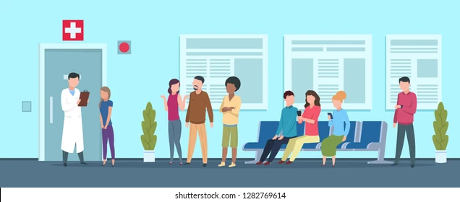
Time can make a difference
Team 1.02

Slide 3



The need
Time to access Patient's info
Know vaccination's history
Drug's Allergies?
Team 1.02

Slide 4
Our Solution
Quicker and easier access to a patient's medical information.
Very sensitive information so will be managed by government.
From patient's vaccination and immunization to health pass usage
Expandable for other scenarios like passports, accidents, natural disasters and more.
Read vaccine's bar code
Inform about vaccines availability
Team 1.02

Slide 5

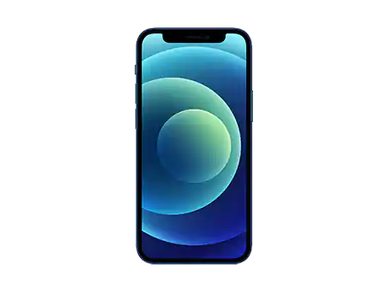

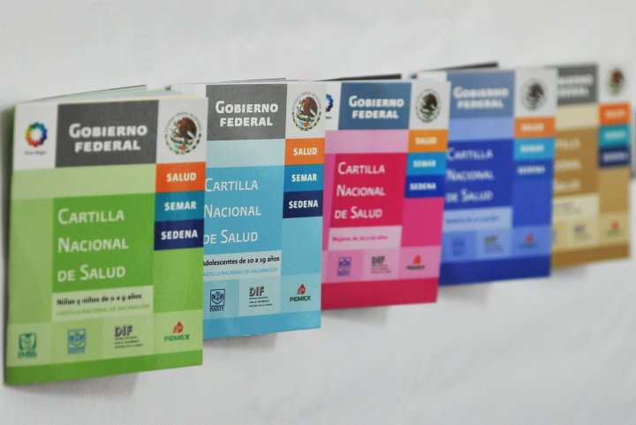
Our Solution vs. The Competition
Team 1.02

Slide 6
Our Solution vs. The Competition
6
Benefits | Our Solution | Public Health | Private Sector
Intuitive to Use | X
Cost to Use | Free | Free | Depends on hospital
Users | Nurses/Patients/Families/Clinicians | Clinicians/Nurses | Clinicians/Nurses
Vaccination & Immunization Records | X | On paper | On paper
Provide health pass | X
Easy Access to personal health data | X | On site | On site
Team 1.02

Slide 7

Scalability
The patient can look at his medical data records and generate a QR to share them
Grant access to nurses to patient's data and scanning the vaccine
We plan to begin with 1 pilot city and move in less than a year to an entire state.
Team 1.02
1.02

Slide 8

Viability
The government does not have a solution aside to papers and onsite records
Team 1.02

Slide 9






The Team
9
Team 1.02

